Slide 1
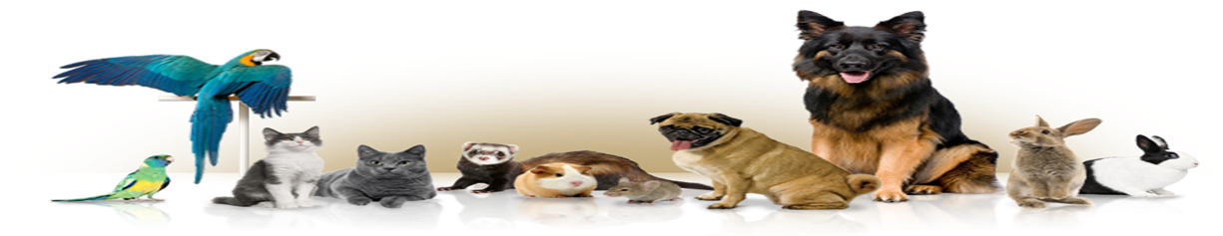
Pet Diet and Healthcare Planner
Group ID: IT-F17-14

Slide 2
Pet Diet and Healthcare Planner
Introduction
Problem Description
Tools and Technology
Implementation
Methodology
Future enhancement
Social Impact

Slide 3
Introduction
As per as our final year project
Industrial
Innovative
Problem solving

Slide 4
Problem Description
1. Pet Diet and Healthcare Planner is basically a requirement for
Islamabad Pets & Avian Hospital G-10/4

Slide 5
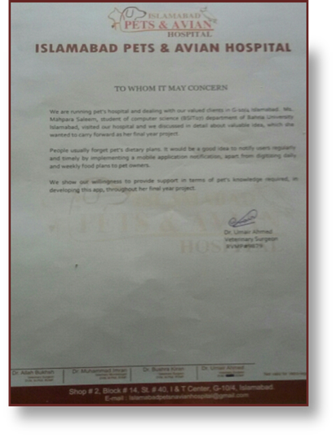

Cont…

Slide 6
Problem Description
2- Pet planner is targeting the needs of layman who is keeping pet.
Usually , when we buy a pet we don’t know proper pet diet plan( with respect to pet age and specie) and healthcare precautions.
People forget to feed their pets on time because of working in office or many other reasons.

Slide 7
Problem Description
There are very few Application available on Google Play store but have limited features.
for example:
Pet Coach :
https://www.petcoach.co/
web application limited to take an appointment from the veterinary doctor.
Pet First Aid:
https://play.google.com/store/apps/details?id=com.cube.arc.pfa&hl=en
Android application Include videos and photos (how to take care of pets).

Slide 8
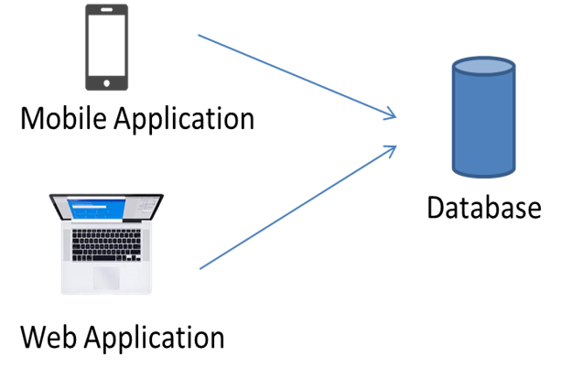
Pet Diet and Healthcare Planner
Pet Diet and Healthcare Planner is basically a mobile and web
base platform focus on most common pets (cats, dogs, chickens,
hens and fishes) and their common breeds.
Generate Pet Diet Plan
Pet common diseases
Generate Alarm Notification
Treatment suggestion
Appointment

Slide 9
Tool and Technology
TOOLS:
Software:
Android Studio 3.0.1
Adobe Photoshop, Canva
Sublime text (website)
Ms Office
Hardware:
Laptop ,Tablet
Android Phone, Android Cable
TECHNOLOGY:
Cloud base server(Firebase)
launched by Google.

Slide 10
Languages
Android App
JAVA
JSON (Database)
C# (textboxes)
C++ (classes)
Website
Html
CSS
JavaScript

Slide 11
Implementation
Database
Methodology
Algorithm

Slide 12
Why Firebase Database?
Most secure
Highly responsive
App does not crash
Analysis report
User authentication
Storage
Free Hosting
Best for new business

Slide 13
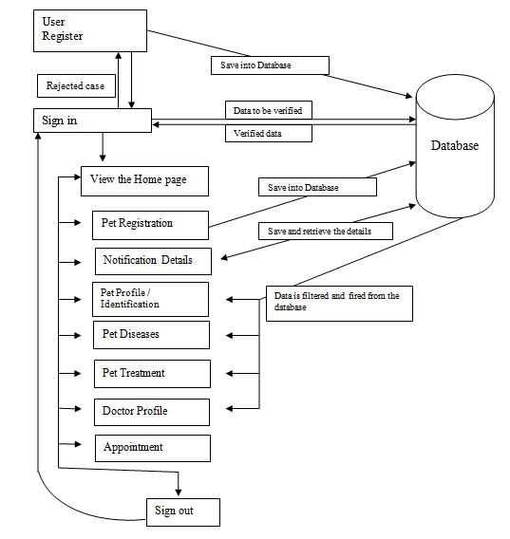
Methodology
/ Diet plan

Slide 14
Algorithm
Separate algorithm for android and web application.
Firebase supports java. While web application base upon html,css, JavaScript.
login /registration –shared preferences + Firebase Authentication
Diet plan/ Diseases - Picasso library
Alarm Notification –Local Memory
Appointment – email / data snapshot

Slide 15
Future enhancement
Application can be enhance for
Pet Tracking
More verity of pets

Slide 16
Social Impact
So, I feel like we should be developing such apps to faster the segment of our society.
Also, this application will be very beneficial for the vet hospitals and people of our society as well as it target multiple requirements.

Slide 17
Any Question ?

